Slide 1
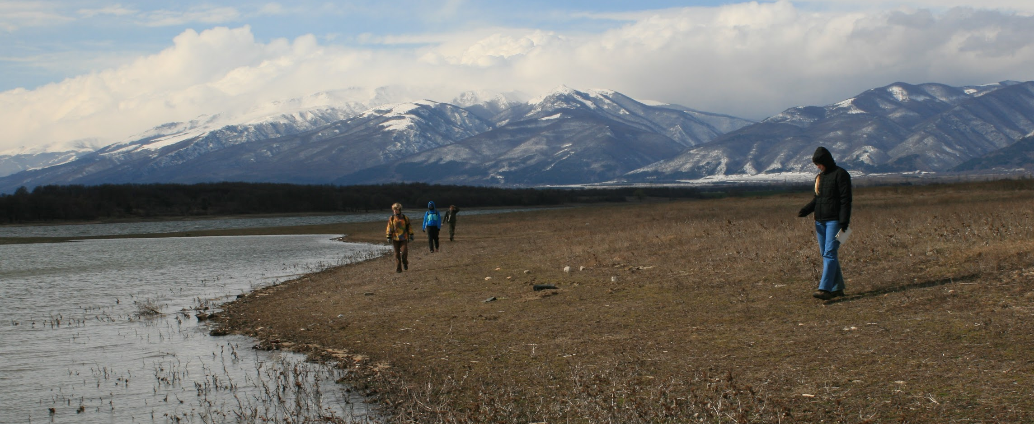
History and Archaeology
Shawn Ross
01 April 2017
Notes:
I am a landscape archaeologist. I do survey - walk the landscape. Instead of digging a signle site, I apply archaeological methods to entire landscapes in order to look for patterns in human behavior.

Slide 2
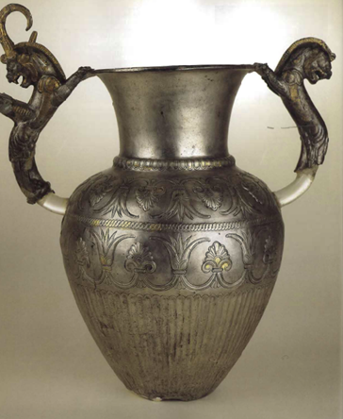
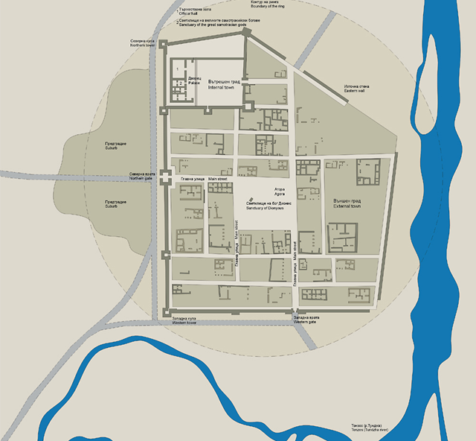
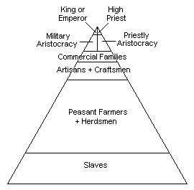
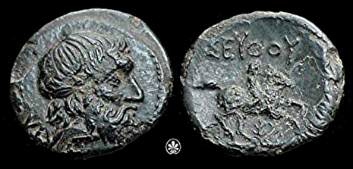
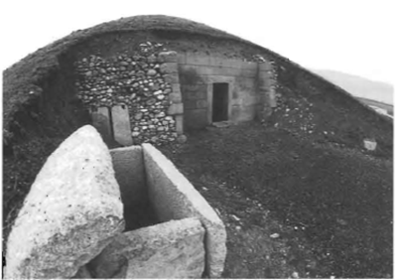
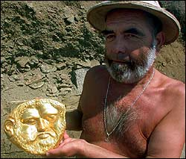
Socio-cultural Complexity
Ancient historical sources say:
Thracians had an arkhe
Mortuary data: very rich burial tombs, one city excavated
What was missing: large scale regional data on settlement distribution and hierarchy, and population trends.

Slide 3
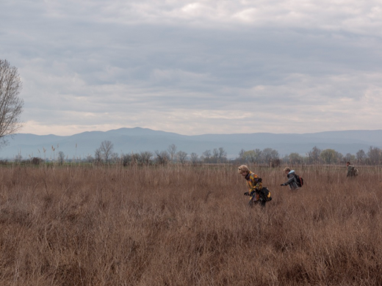
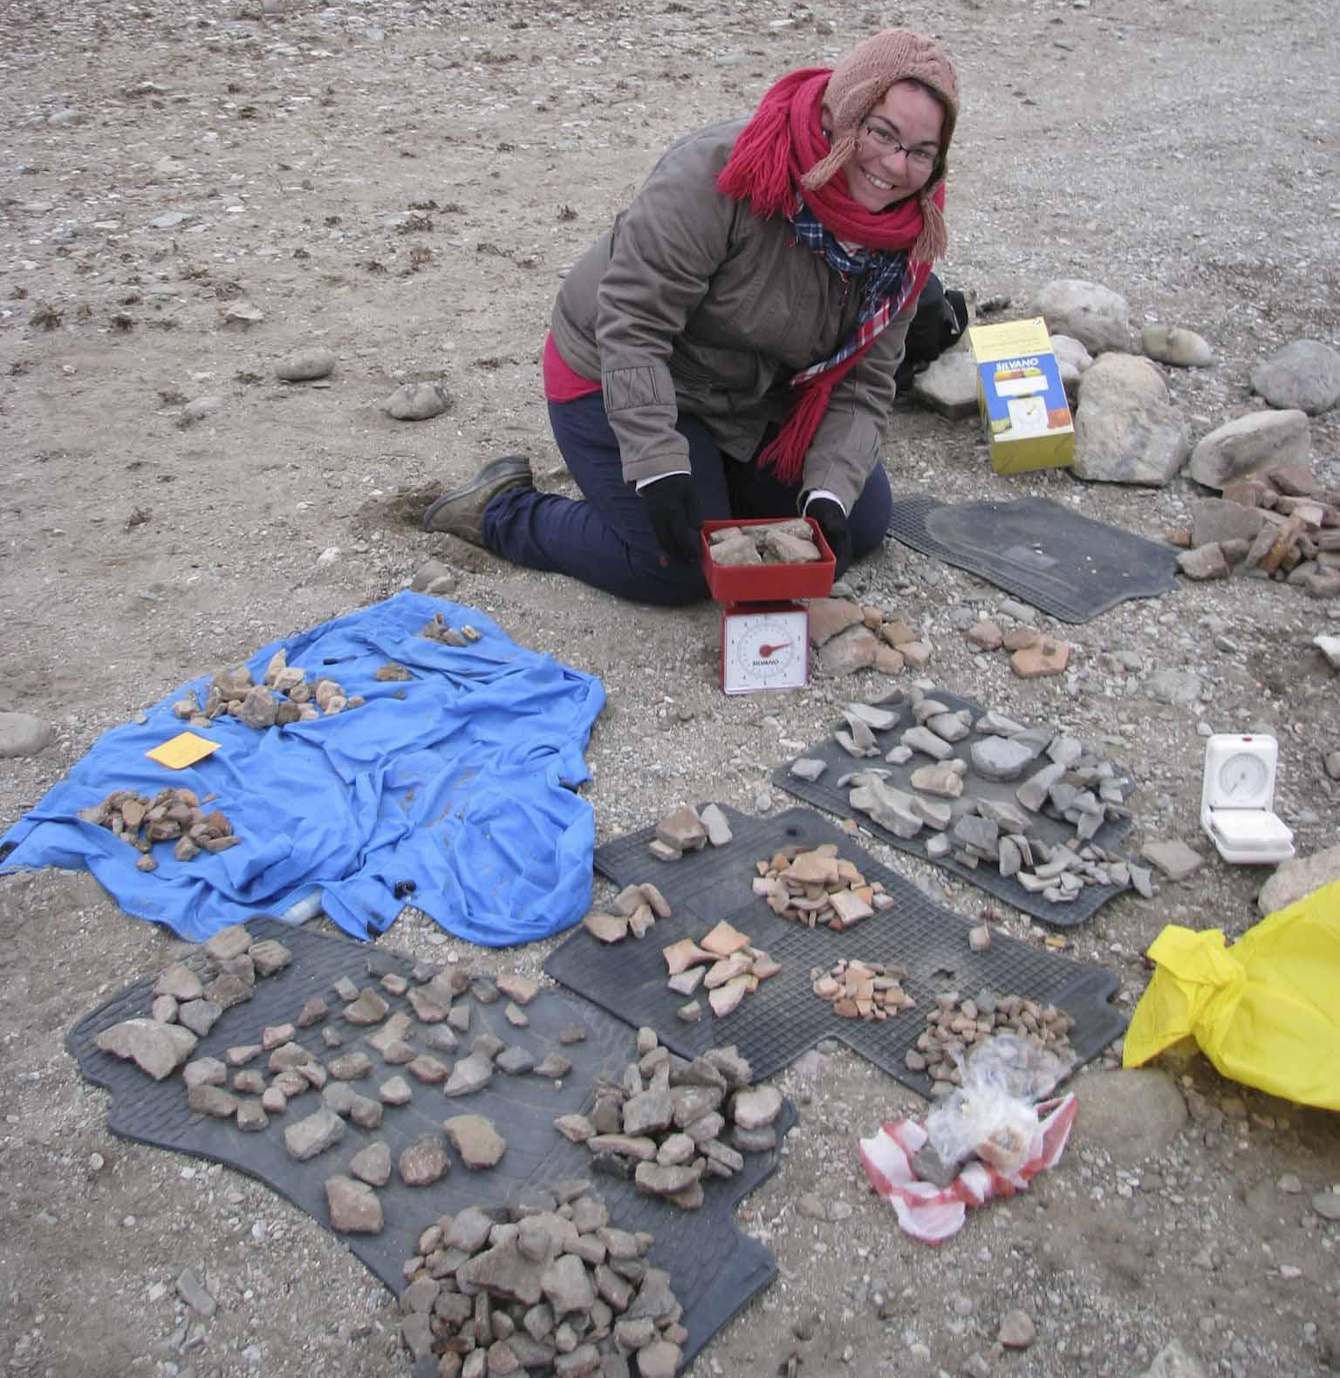
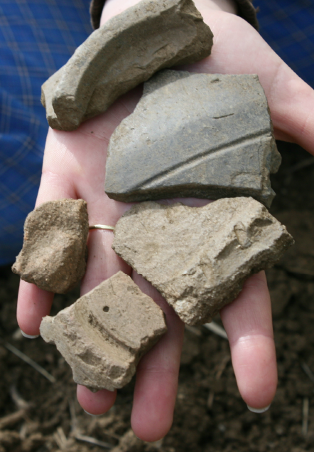

Slide 4
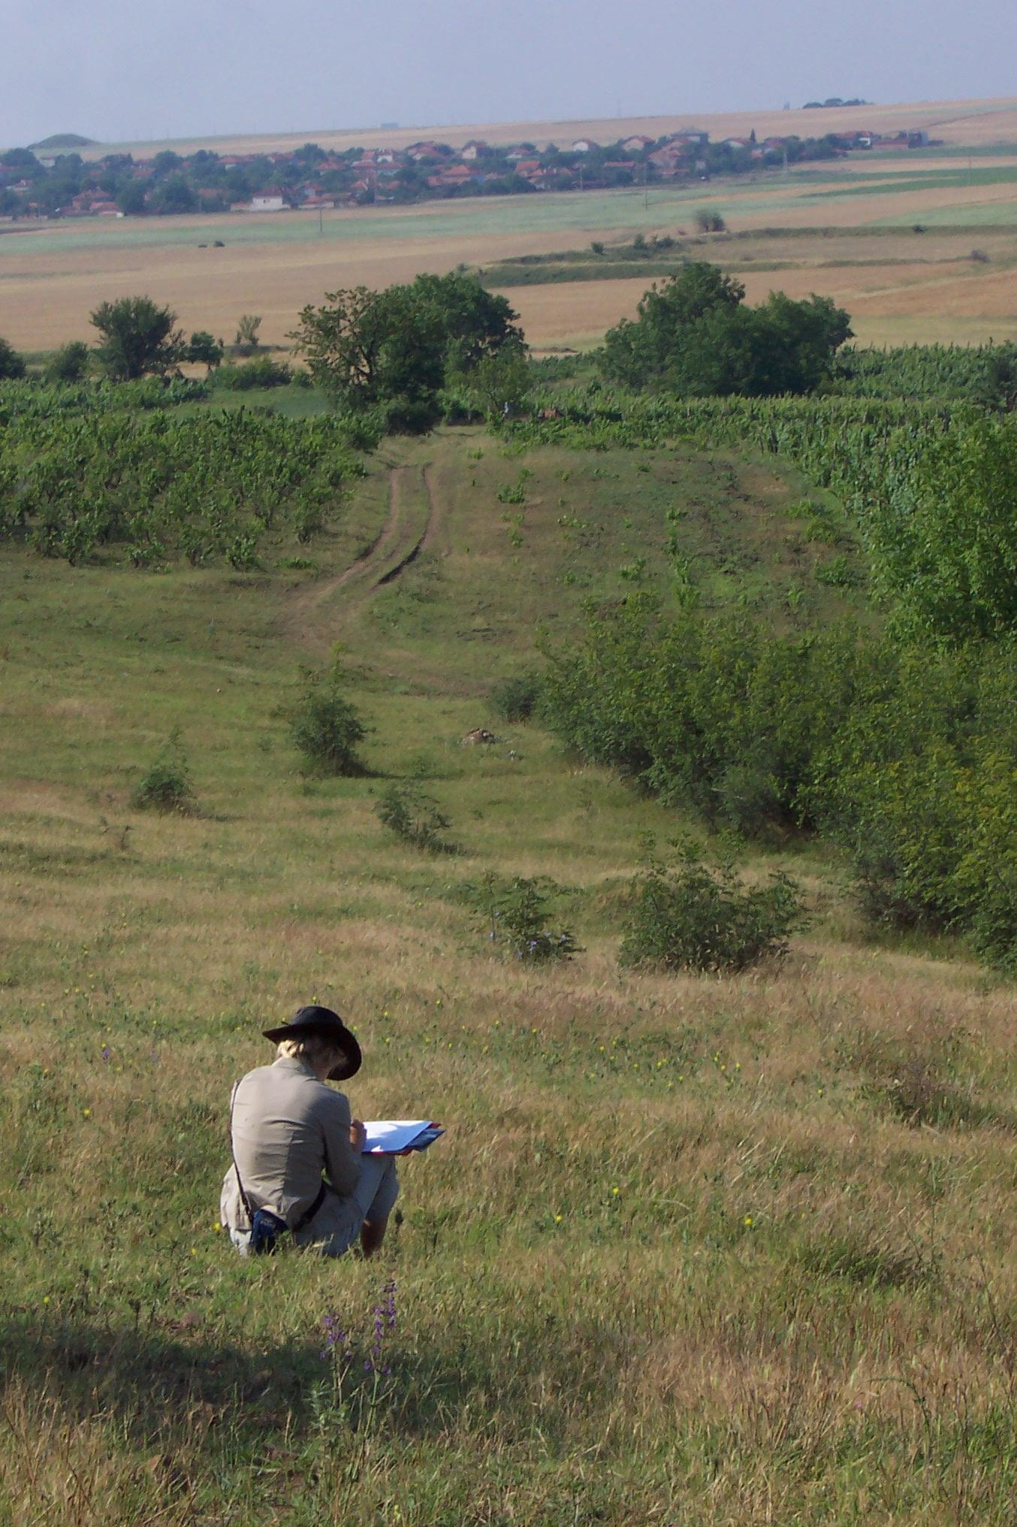

Slide 5
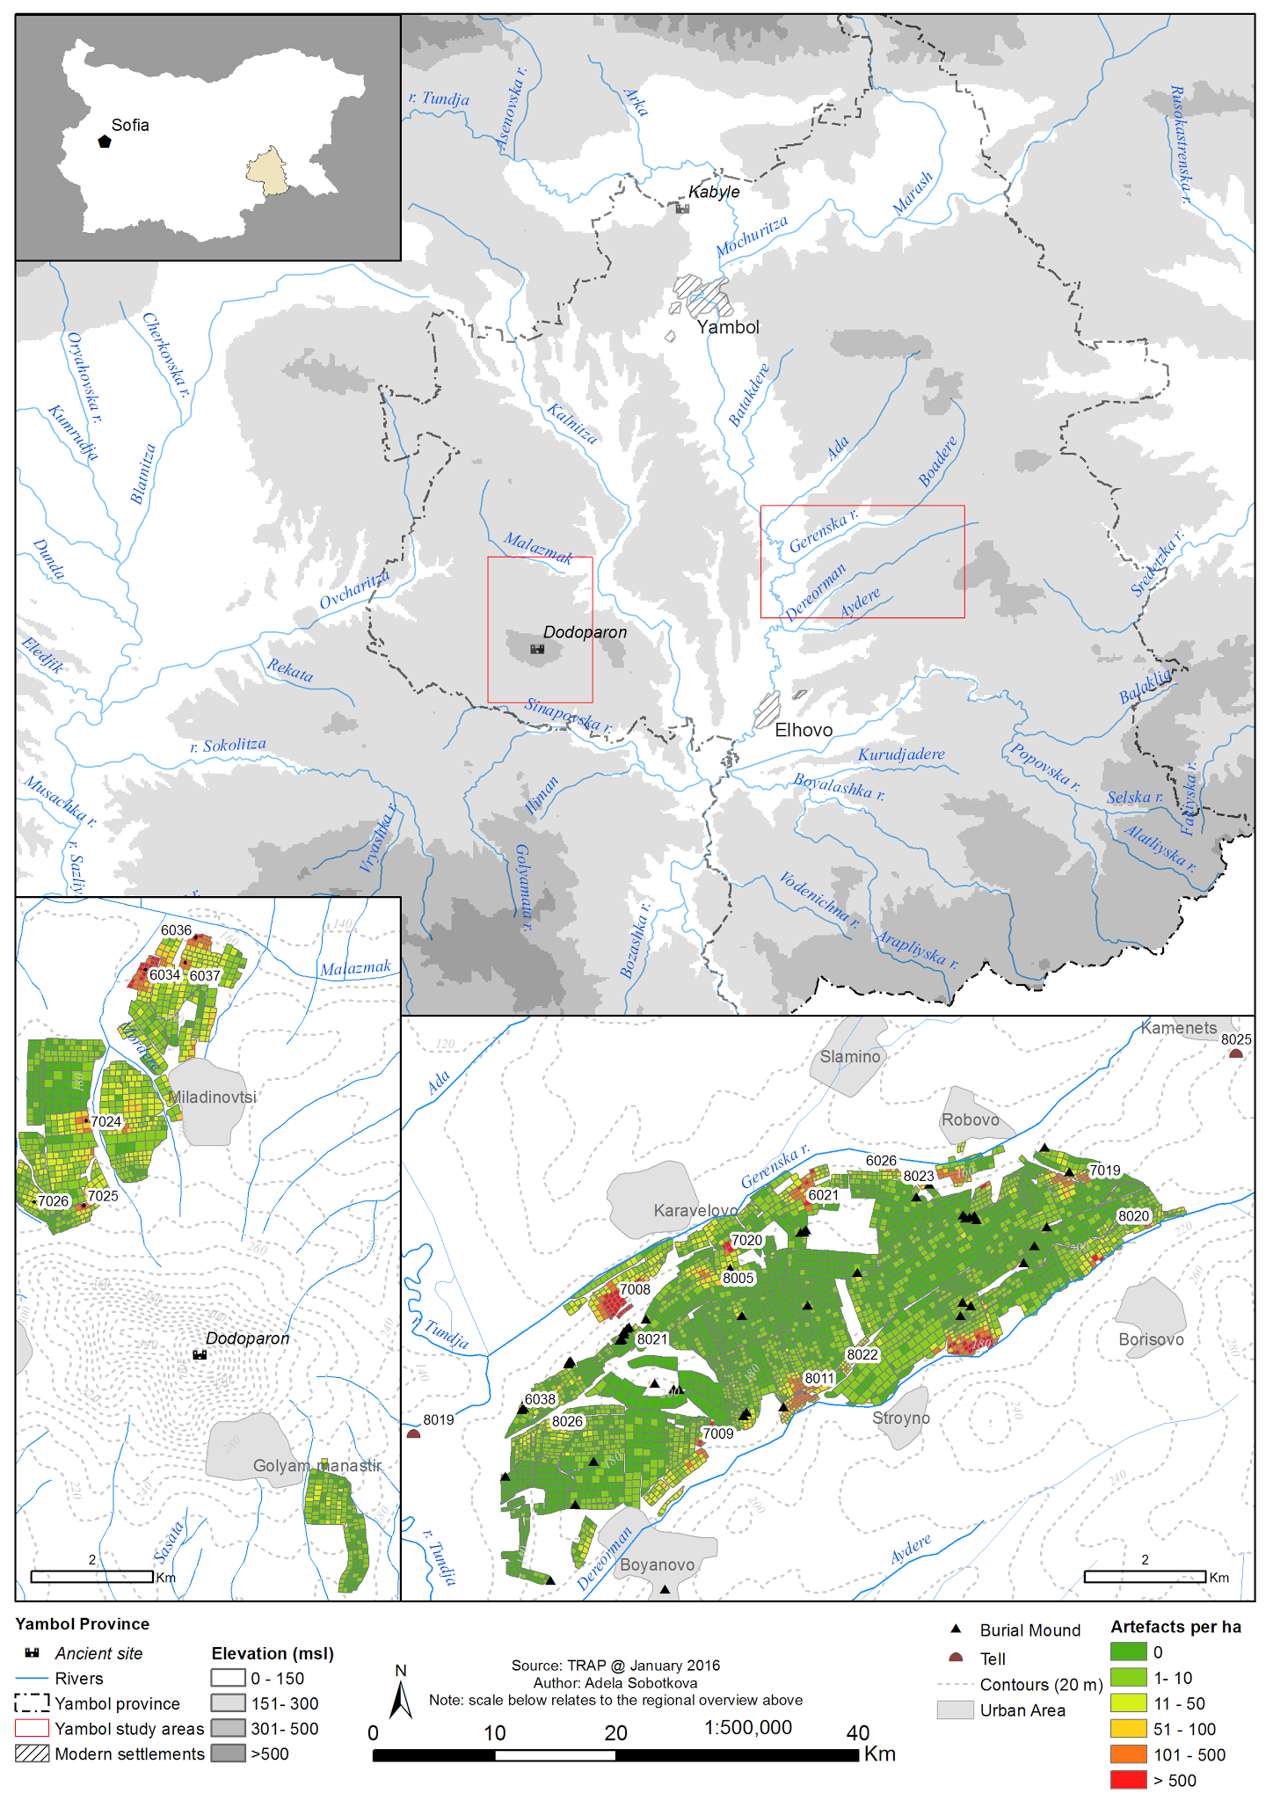

Slide 6
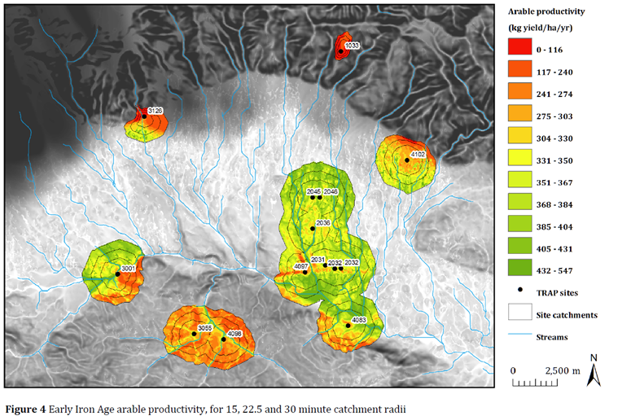
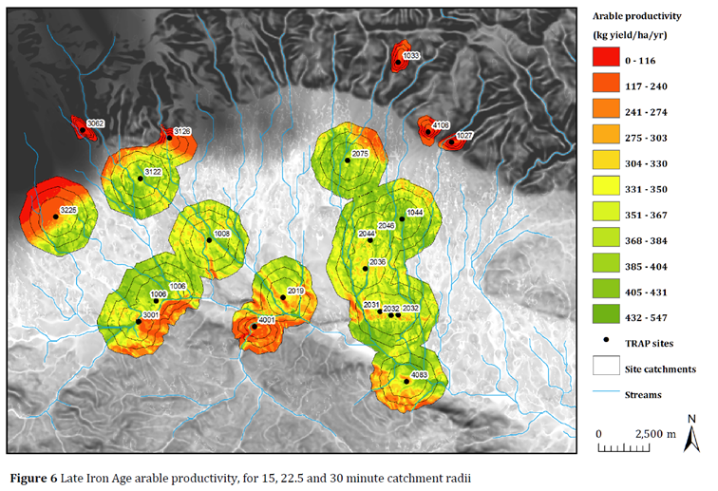
Catchment Analysis - Kazanlak
The resource area of an archaeological site;
ISOCHRONIC CATCHMENTS
Notes:
the geographical area in which the inhabitants of a village or camp obtain resources.

Slide 7
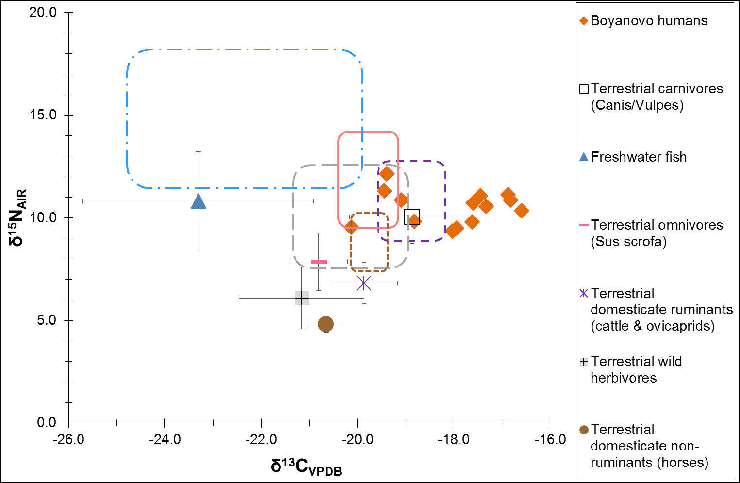
Isotope analysis

Slide 8
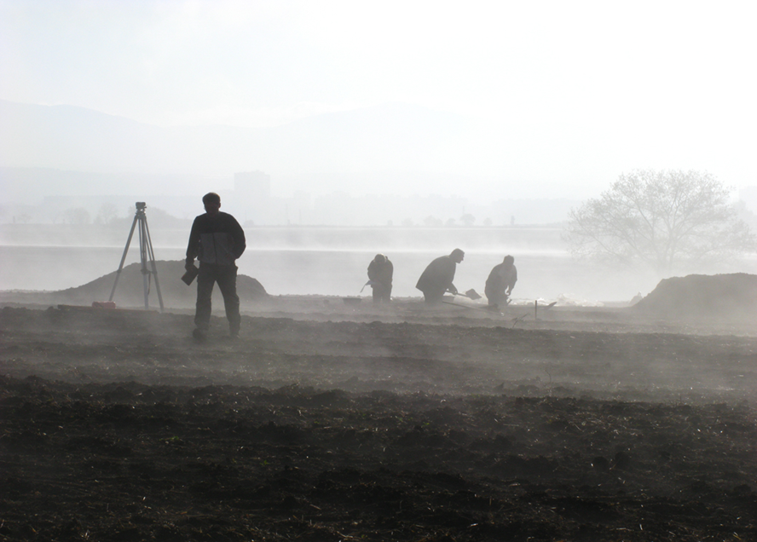
Thank you!

